Slide 1


MALIGNANT COMMENT CLASSIFICATION
Submited By
Nimesh Kumar Roy

Slide 2
INTRODUCTION
People use social media as a platform to express their opinions and views.
They do this freely and without any reluctance.
With it comes the risk of cyber abuse and harassment, which can put an end to people expressing themselves and giving up on seeking opinions.
To protect the users from cyberbullying, every organization should have an automated system in place to identify such malicious comments and suitable actions against the same.

Slide 3
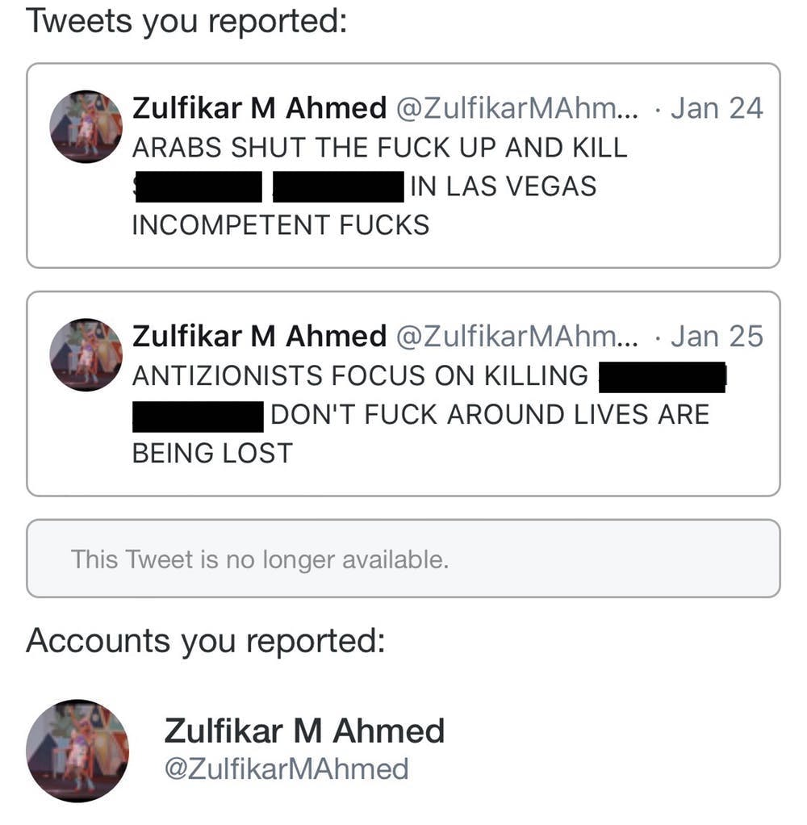

OBJECTIVE
We have undertaken this project to classify the comments made by different users on social media platforms, like the tweets from Twitter, facebook,instagram etc. , to build a model that is capable of detecting and classifying these comments into various classes like threat, abuse, rude and loathe.

Slide 4

PREPROCESSING OF THE DATA
We have performed the following preprocessing on the data:
Removed punctuations
Removed the stop words
Stemming and lemmatization
Applied counter vectorizer

Slide 5
DATA MODELLING
Problem Transformation Method
We used the Multinomial Naïve Bayes classifier for classification.
We used this classifier, since it is suitable for classification with discrete features.
The algorithm estimates the conditional probability of a particular word given a class as the relative frequency of term t in documents belonging to class(c).
The variation takes into account the number of occurrences of term t in training documents from class (c),including multiple occurrences.

Slide 6
DATA MODELLING
Adaptation Algorithms
We used the Backpropagation for Multilabel Learning algorithm.
The BPMLL algorithm is a back-propagation neural network algorithm adapted for multi-label classification by having multiple binary outputs as the label variables.
It helped to classify the tweets in real-time as the algorithm changes its behavior at the time it is run, based on information available and on a priori defined criterion.

Slide 7
DATA VISUALIZATIONS

Slide 8
DATA VISUALIZATIONS

Slide 9

ANALYSIS OF RESULTS
Upon testing the models, on the malignant comments we have analyzed the following:
Most of the comments are up to 200 characters long.
Most of the tweets fell under the “malignant” class.

Slide 10
CHALLENGES
Multiple labels – For Binary classification we have many models available but for multilabel classification the selection of models decreases drastically.
Collection of USABLE DATA – although we extracted over 100000 records, only 14000 records were usable among them.
Cleaning the data – Due to the character limit tweets contain a lot of short forms which are different to classify using bag of words model.
TWITTER RATE LIMIT – Due to the twitter rate limit we were getting timed out every 15 mins due to which the data collection process took over 8 hours.

Slide 11
REFERENCES
https://en.wikipedia.org/wiki/Multi-label_classification
https://www.kaggle.com/c/jigsaw-toxic-comment-classification-challenge
https://ac.els-cdn.com/
http://ceur-ws.org/Vol-1751/AICS_2016_paper_33.pdf
https://www.analyticsvidhya.com/blog/2017/08/introduction-to-multi-label-classification/
http://citeseerx.ist.psu.edu/viewdoc/download?doi=10.1.1.507.910&rep=rep1&type=pdf
https://dzubo.github.io/machine- learning/2017/05/25/increasing-model-accuracy-by-tuning-parameters.html

Slide 12
THANK YOU

